Slide 1

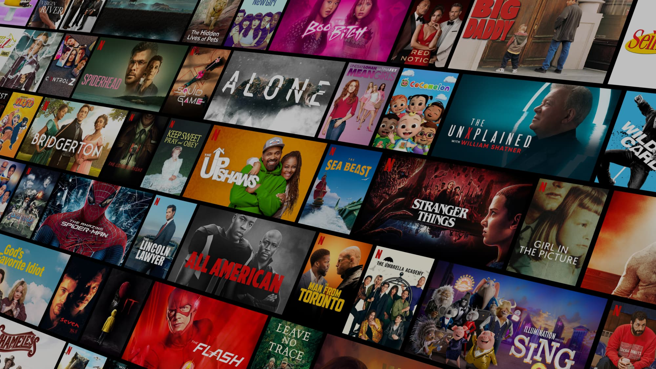
ONLINE
STREAMING
PLATFORM
who was?

Slide 2
DIYAA SANTHOSH 20Z316
KAVIN ARAVINDHAN R 20Z325
LAKSHMI PRIYADARSHINI M 20Z327
HARDIK P 20Z367
YADAV RANGANATHAN 20Z355
OUR
TEAM
Who did it?

Slide 3
Why we chose this topic?
Netflix

Slide 4
Software Requirements
Node js
React Js
Python
HTML
CSS
Google Chrome
Javascript
Libraries and frameworks
Pandas
Scikit learn
Flask
Database
Firebase
requirements

Slide 5
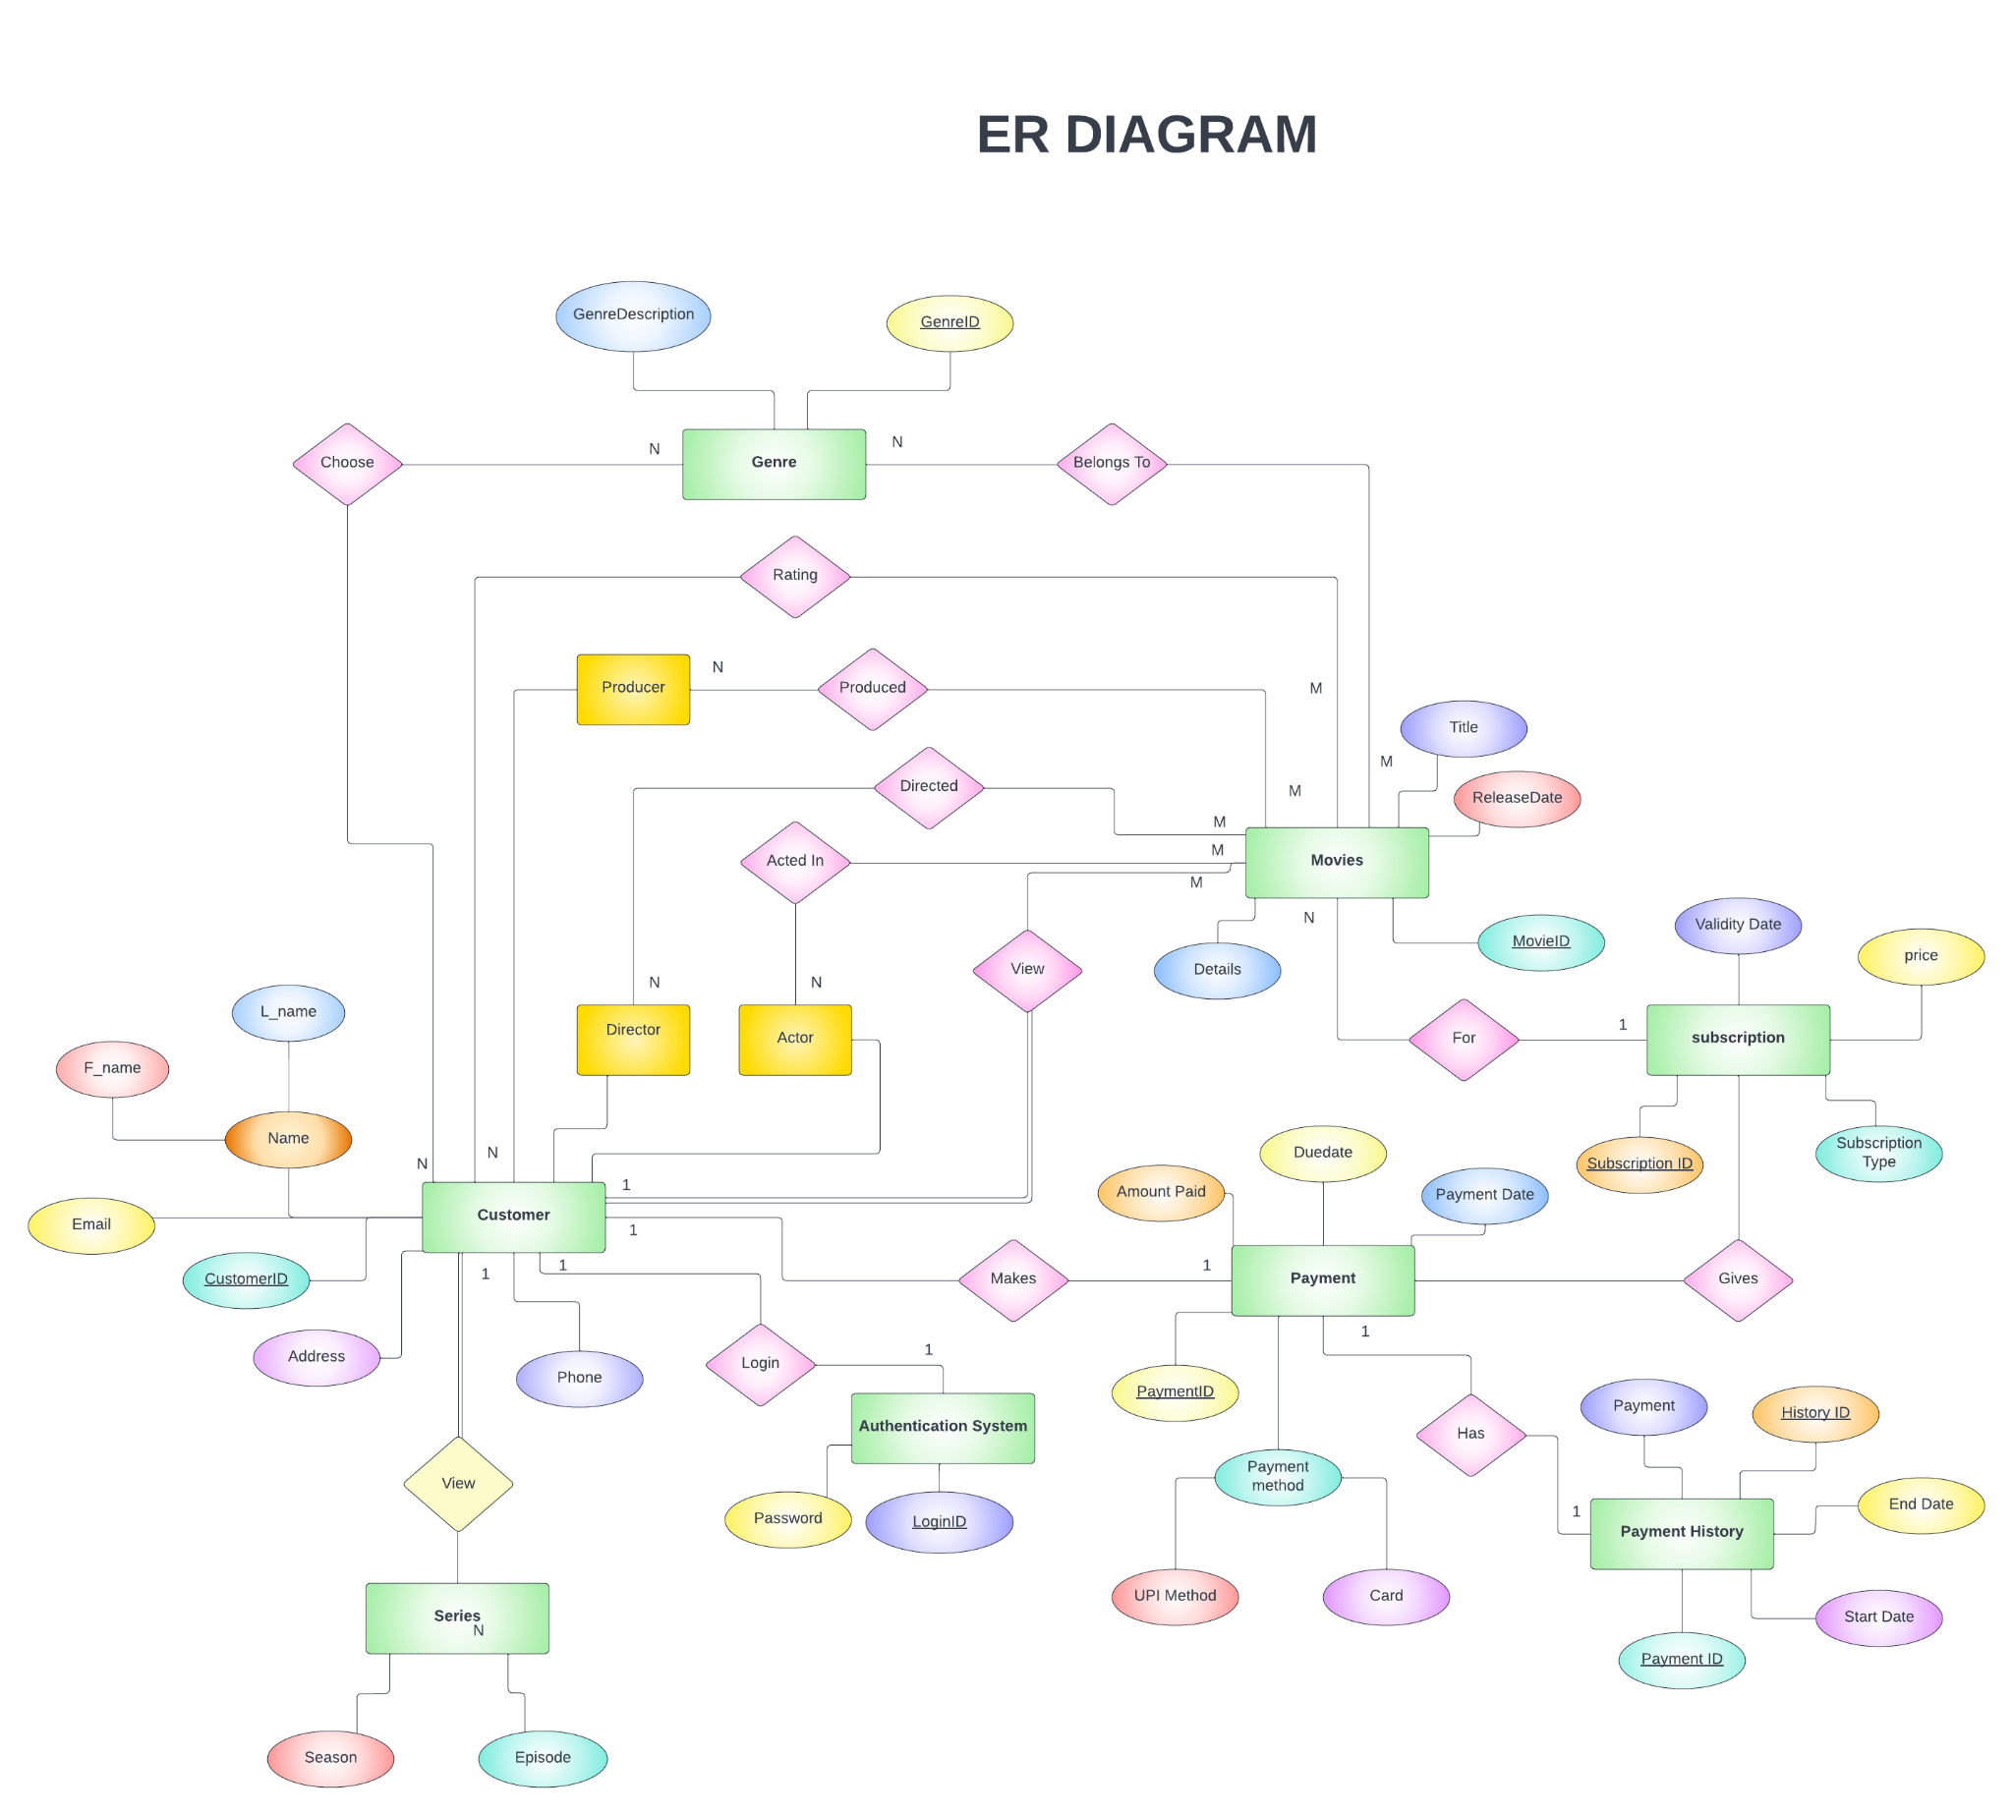
Entity Relationship diagram
where?

Slide 9
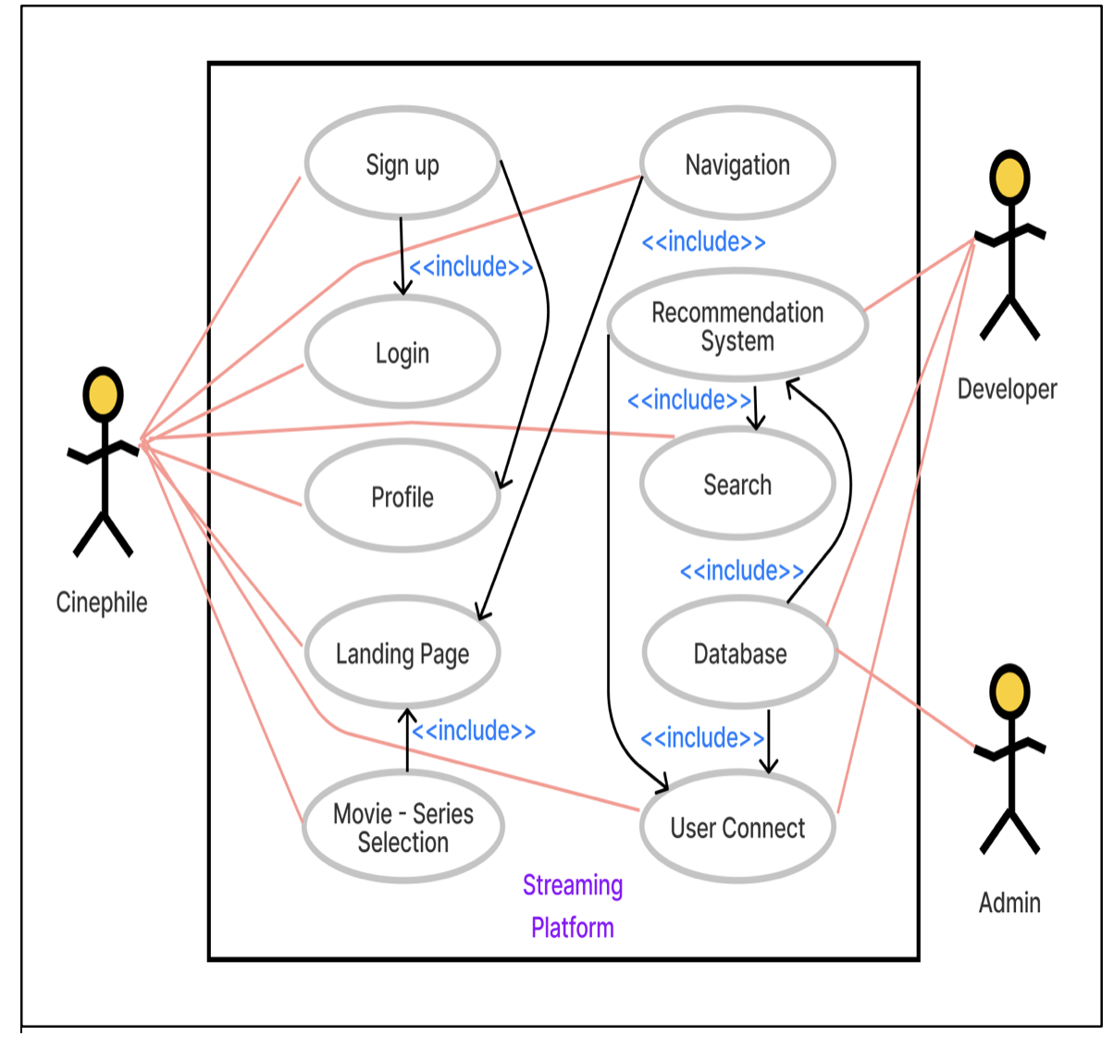
Use case Diagram
where?

Slide 10
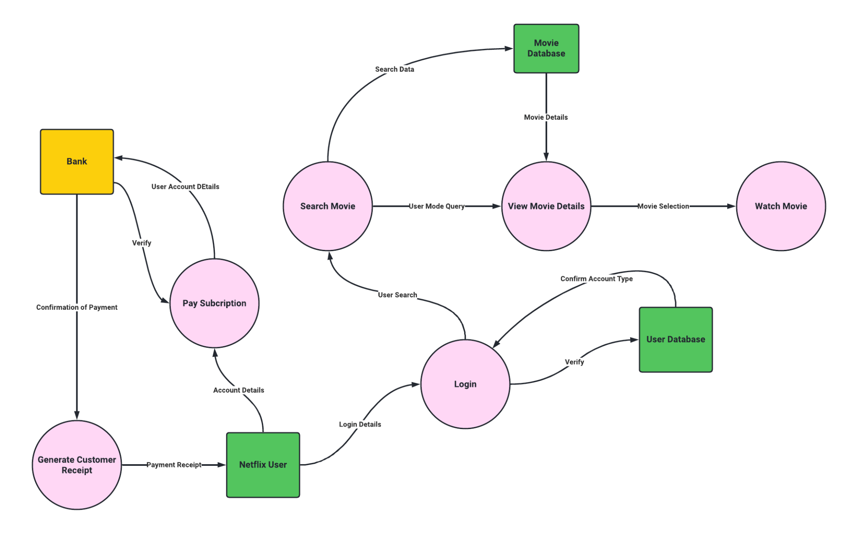
Data flow Diagram
where?

Slide 11
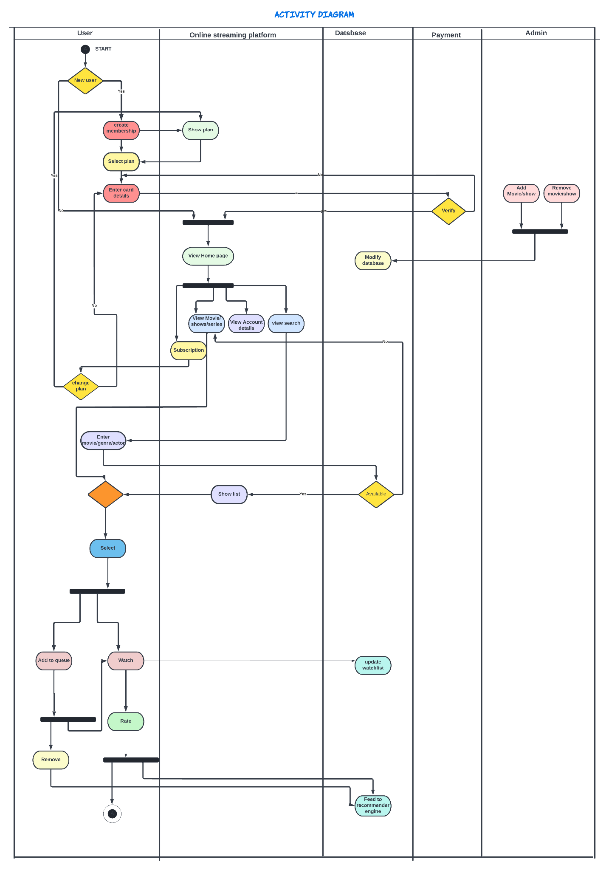

Slide 12
Activity Diagram

Slide 15

MODULES ON PROCESS
03
01
LOGIN/REGISTER
HOME PAGE
02
RECOMMENDATION SYSTEM
04
SEARCH
source?

Slide 16
Recommendation
System
Recommender system uses two techniques:
  Content-based filtering
  Collaborative filtering
Our system used TMDB_5000_moviedataset
TMDB_5000_creditsdataset
To find the similarity between movies for our content based method, we’ll use a cosine similarity function.
module

Slide 17
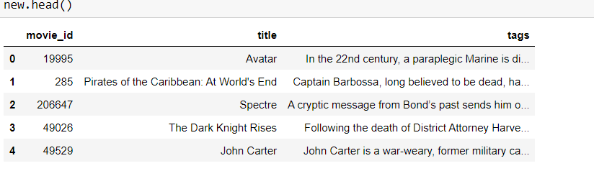
Datasets are merged and essential columns - genres,keywords,overview,movies_id,cast,crew,title are retained.
A new dataframe with the following attributes is created- id,title,tag

Slide 18
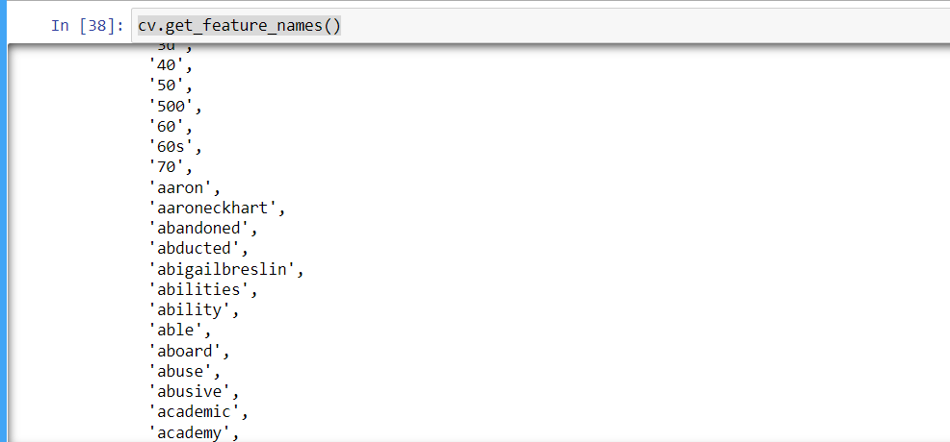
5000 frequently appearing words are extracted using get_feature_names function in CountVectorizer class.

Slide 19
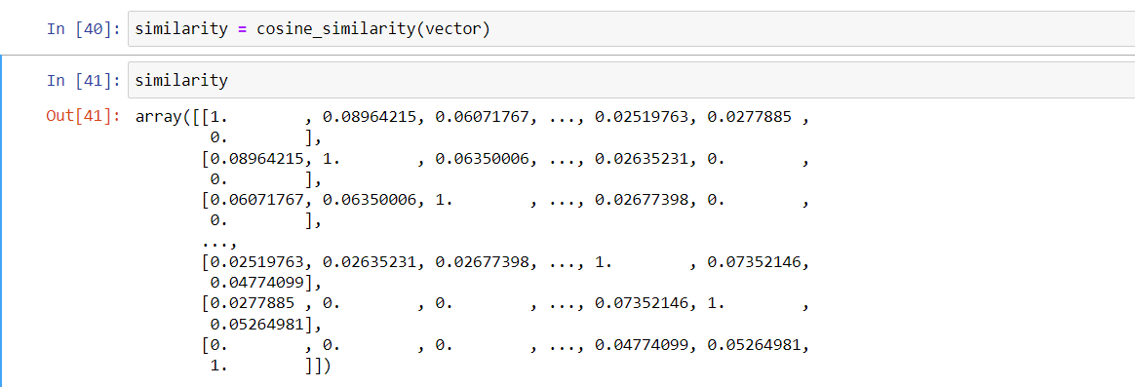
Cosine similarity is a metric used to determine how similar two entities are irrespective of their size. Mathematically, it measures the cosine of the angle between two vectors projected in a multi-dimensional space.

Slide 20
THANKS
who was?

